Slide 1

Healthify - Transforming Healthcare Management
Team 4:
Mamoon Mohammed, Priyanka Reddy Pallapolu , Maddula Dheeraj, Surekha Maruti Salunkhe , Afreen Shaik, Arjun Reddy Nareddy , Mattapally Madhvika, Balu Venkat Motaparthi , Nikhil Ravuri, Abhilash Reddy Battu, Manikanta Kethireddy, Vinay Pusuluri, Likith Nadendla, Venkata Reddy Doggala, Sai Vamshi Gardas, Naresh Chenna .

Slide 2
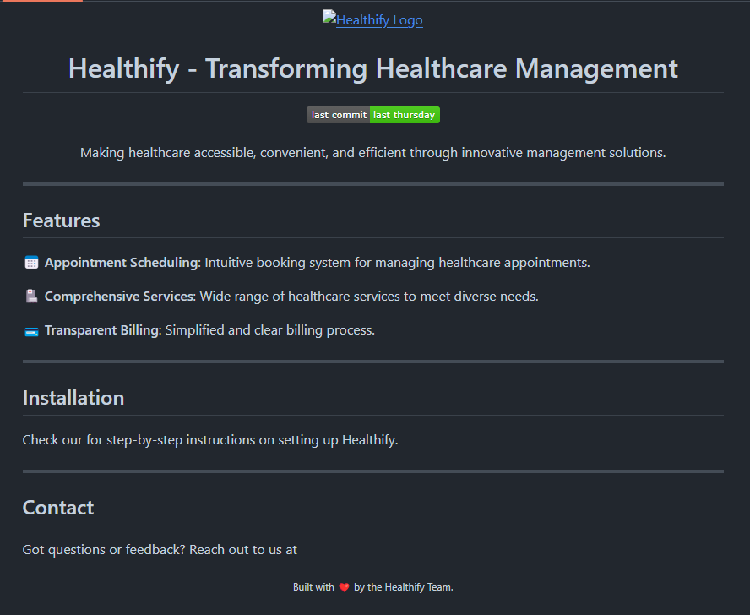
GitHub URL:
https://github.com/pusulurivinay/healthcare

Slide 3
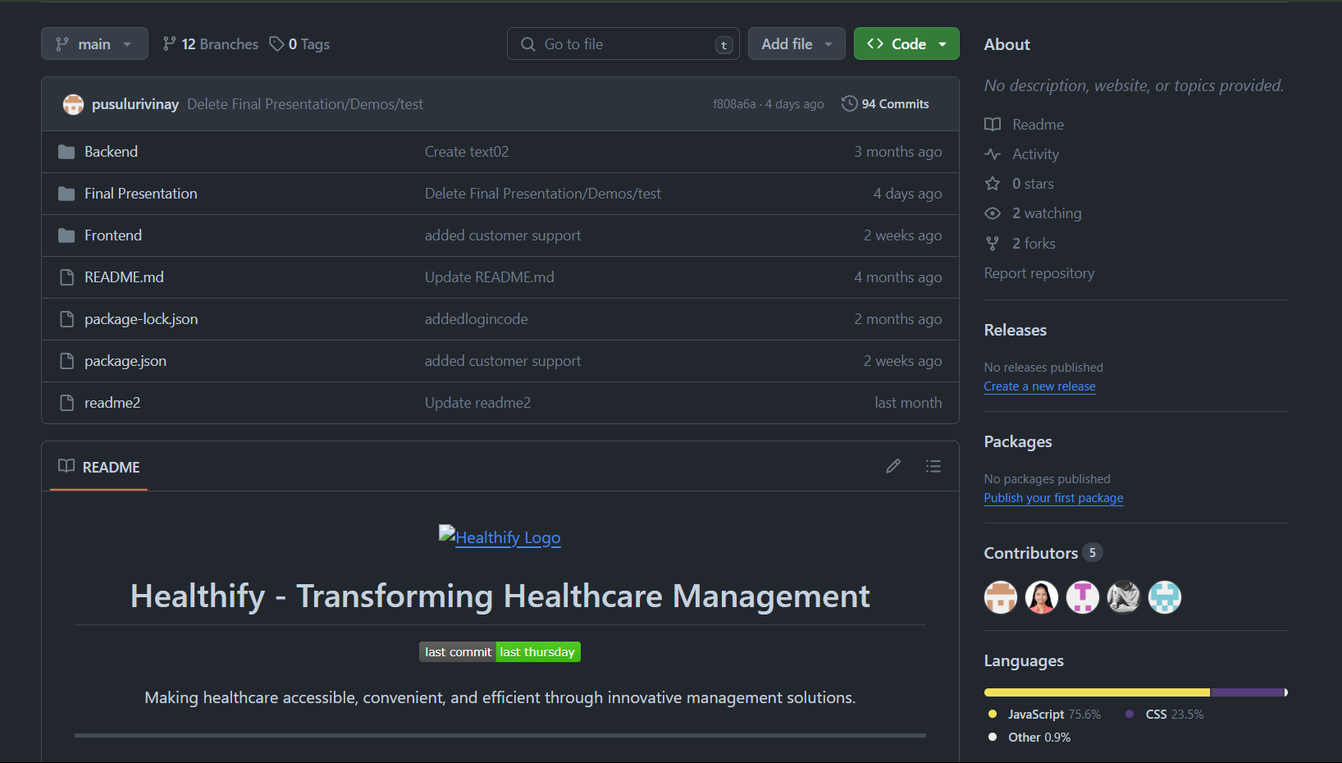
Repository Structure

Slide 4
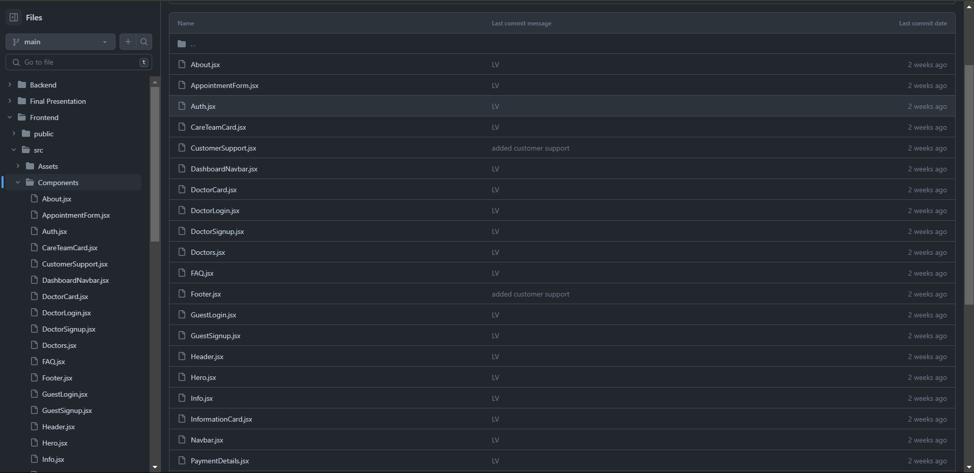
Repository Structure

Slide 5

Source Code

Slide 6
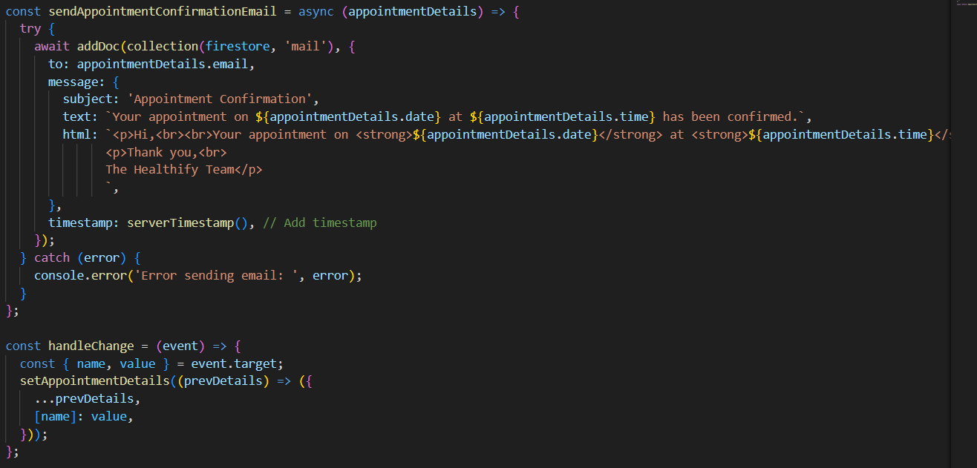
Email Function

Slide 7
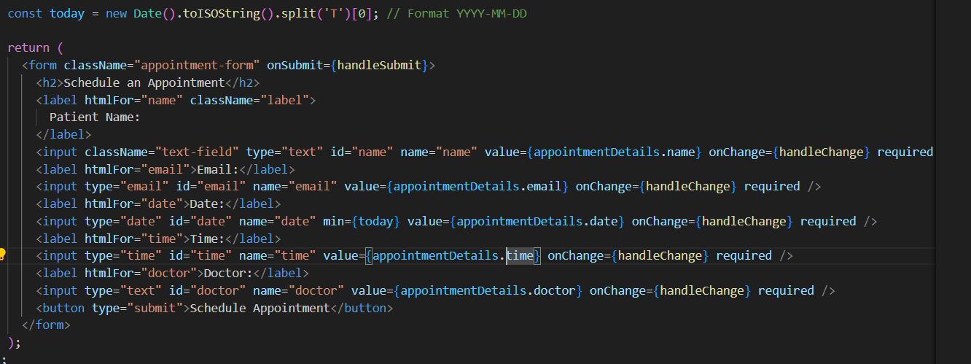
Appointment Form

Slide 8
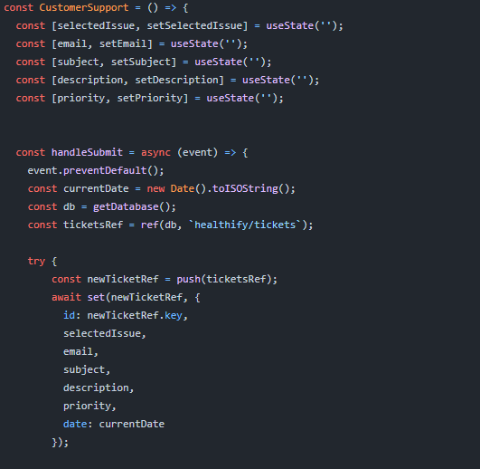
Customer Support Tickets

Slide 9

THANK YOU
Team 4

